Slide 1
Capstone Project - 2
YES BANK STOCK CLOSING PRICE PREDICTION
By- Suvarna Gadakh

Slide 2
Contents
Problem Statement
Data Understanding
Data set loading
EDA
Feature Engineering
Model Implementation
Linear Regression
Lasso Regression
Ridge Regression
Model Explainability
Conclusion

Slide 3
Problem Statement
Yes Bank is a well-known bank in the Indian financial domain. Since 2018, it has been in the news because of the fraud case involving Rana Kapoor. Owing to this fact, it was interesting to see how that impacted the stock prices of the company and whether Time series models or any other predictive models can do justice to such situations. This dataset has monthly stock prices of the bank since its inception and includes closing, starting, highest, and lowest stock prices of every month. The main objective is to predict the stock's closing price of the month.

Slide 4
Data Understanding
Yes bank close price prediction project was done by Umesh Pardeshi. In this project, we got single CSV files as input. The CSV files are data_YesBank_StockPrices.csv, this file consists of around 186 rows and 5 columns. As we have a single data set so we decide to work in collaboration with teammates. First, we imported all required libraries for further evaluation Yes Bank is a well-known bank in the Indian financial domain. Since 2018, it has been in the news because of the fraud case involving Rana Kapoor. Owing to this fact, it was interesting to see how that impacted the stock prices of the company and whether Time series models or any other predictive models can do justice to such situations. This dataset has monthly stock prices of the bank since its inception and includes closing, starting, highest, and lowest stock prices of every month. The main objective is to predict the stock's closing price for the month.

Slide 5
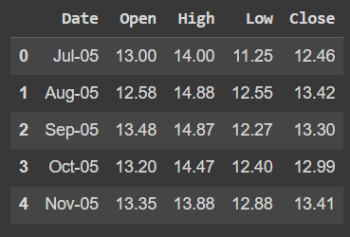
Data set loading
We have loaded data using panda’s read_csv function.

Slide 6
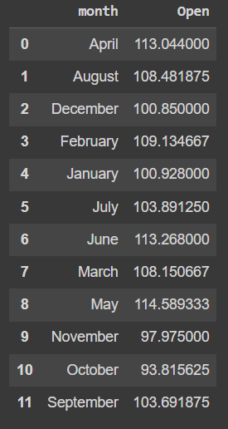
EDA
1. Stock Open mean price as on month

Slide 7
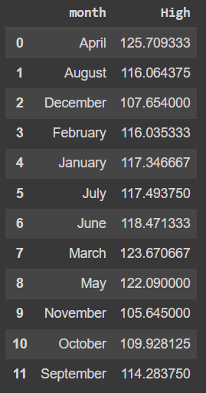
EDA
2. Stock High mean price as on month

Slide 8
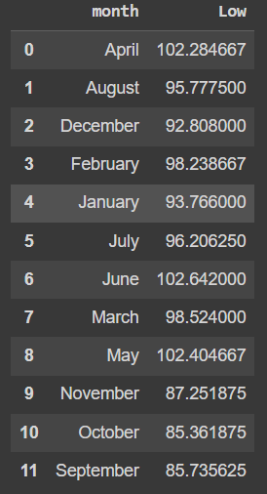
EDA
3. Stock Low mean price as on month

Slide 9
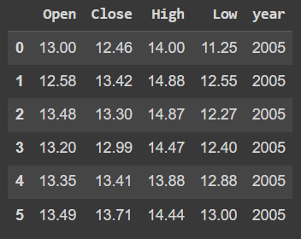
EDA
4. stock open, close, high and lower price as on year 2005

Slide 10
Model Implementation
Linear Regression
Lasso regression
Ridge regression

Slide 11
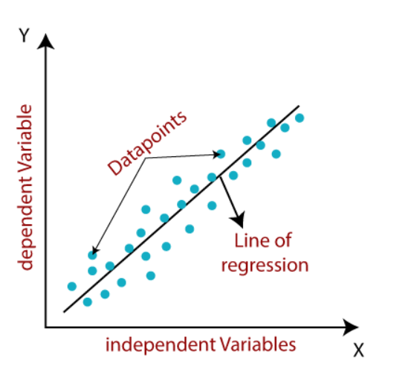
Linear Regression
Simple Linear Regression: If a single independent variable is used to predict the value of a numerical dependent variable, then such a Linear Regression algorithm is called Simple Linear Regression.
Multiple Linear regression*: If more than one independent variable is used to predict the value of a numerical dependent variable, then such a Linear Regression algorithm is called Multiple Linear Regression.

Slide 12
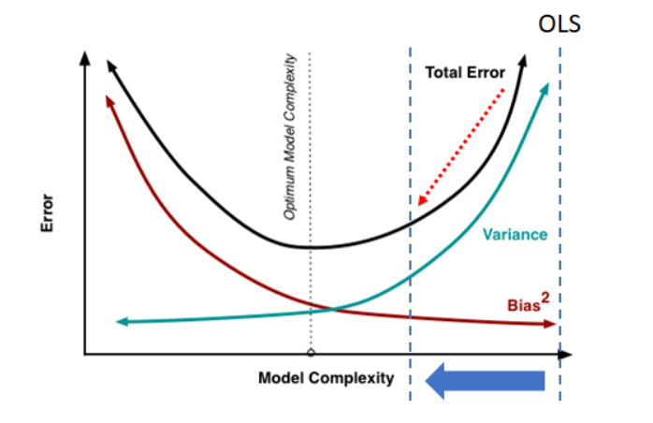
Ridge Regression
Ridge regression is a specialized technique used to analyze multiple regression data that is multicollinear in nature. It is a fundamental regularization technique, but it is not used very widely because of the complex science behind it. However, it is fairly easy to explore the science behind ridge regression in r if you have an overall idea of the concept of multiple regression. Regression stays the same, but in regularization, the way the model coefficients are determined is different.

Slide 13
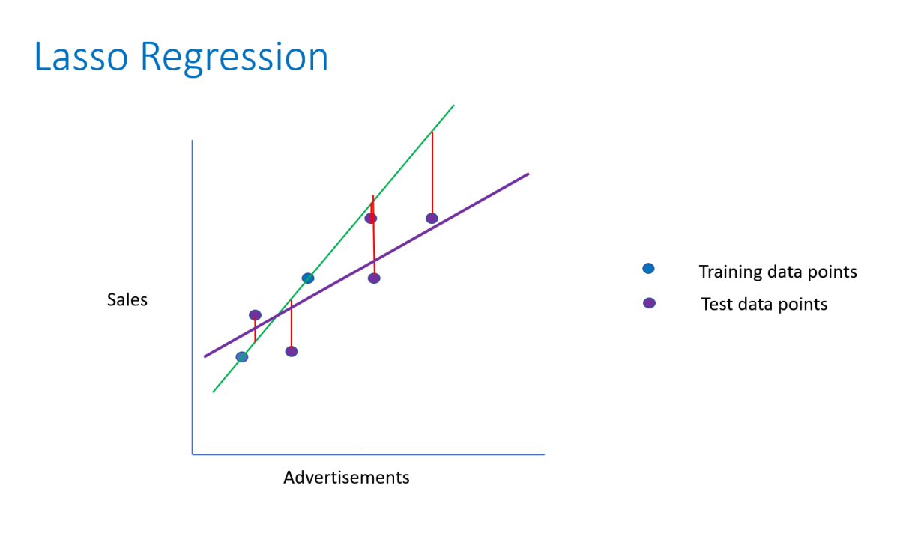
Lasso Regression
Lasso regression is also called Penalized regression method. This method is usually used in machine learning for the selection of the subset of variables. It provides greater prediction accuracy as compared to other regression models. Lasso Regularization helps to increase model interpretation.

Slide 14
Conclusion
Yes bank share Closing price is the minimum in oct month i.e. 93.81.
Yes bank share Closing price is the maximum in Feb month i.e. 114.31.
Yes bank's share Higher price is a minimum in nov month i.e. 105.36.
Yes bank's share Higher price is the maximum in apr month i.e. 125.86.
Yes bank's share Lower price is minimum in oct month i.e. 85.36.
Yes bank's share Lower price is the maximum in Jun month i.e. 102.64. Yes, the bank closing price is the minimum in the month Nov, Oct, and sept as compared to other months.
In 2005 yes bank's share price ranged from 12.6 to ~14.
The Central Bureau of Investigation (CBI) on September 19 filed a charge sheet against Yes Bank co-founder Rana Kapoor in a Rs 466.51 crore bank fraud case, as this news flooded in word stocks price of yes bank rapidly decreased.

